Slide 1

Getting Started with Data Visualization: Elements of Design!
go.ncsu.edu/startviz2
Alison Blaine, Jennifer Garrett, & Hannah Rainey

Slide 2
Goals
go.ncsu.edu/startviz2
After this session you should leave with:
an understanding of the process for making good visualizations
an introduction to core design concepts
exposure to various chart types
practice doing a visualization “make over”
Most importantly, we hope you learn that you can always get more help!

Slide 3
Agenda
go.ncsu.edu/startviz2
Overview
Basic Design Considerations
Characteristics of Bad & Good Visualizations
Best practices for visualizing data
Resources for choosing the right chart type
Hands-on activity

Slide 4
Workshop materials folder
go.ncsu.edu/startviz2

Slide 5
What is data visualization?
Why visualize?
go.ncsu.edu/startviz2
Notes:
Broadly, data visualization is anything that converts data into a visual representation - so a graph, a bar chart, a map.
At least in the libraries, we have heard the term “data visualization” come up more and more often from our users. We don’t argue that visualizations are always needed, but depending on one’s research there are many reasons that might support visualizations as a useful component of data analysis or research in general. It’s easier for our brains to absorb visual information, and so if you need to communicate something quickly about a data set, a visual representation is often a good idea.

Slide 6
Grammar of Graphics
Originated by Leland Wilkinson, simplified by Hadley Wickham and others. A “grammar” for creating graphics gives us tools to create new types of visualizations. Data visualization is taking data and mapping it onto visual aesthetic, (points, lines, bars, etc).
Data
Geometry - visual encoding or symbol onto which the data is mapped. Each geom. has aesthetics (length, position, etc)
Grouping - subsets the data
Statistics - transforms or summarizes data
Mapping - maps the data onto the geometry
Source

Slide 7
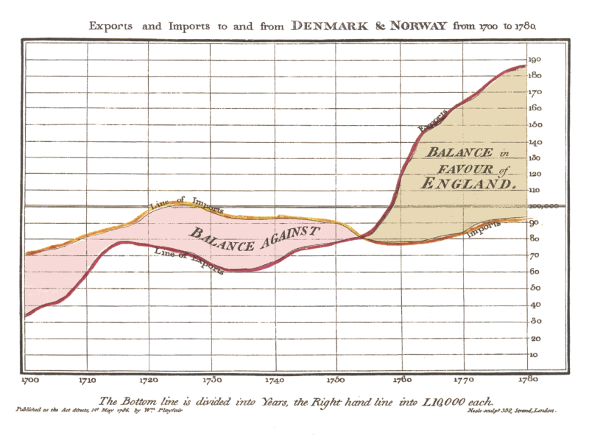
Data Visualization is an old endeavor.
William Playfair, Commercial and Political Atlas, 1786
Notes:
Applying a simplified version of Wilkinson’s grammar onto the earliest recorded modern data visualization (from Scottish engineer & political economist William Playfair, founder of graphical methods in statistics). The geometries are lines. They have the aesthetics of length and position.They are mapped onto a coordinate plane of 2 variables, X = year, Y = monetary amount.
Playfair Originated common chart types, such as line, bar, pie charts. Much earlier visualizations of course exist in human history, including 3d objects, cave paintings and other ways of symbolizing pieces of information about the world that we call data.

Slide 8

New Visualization Challenges
Notes:
Modern data is a verb
Live, dynamic data streams
High Velocity, high volume, and/or high variety (big data)
High dimensional data (ex: genetic data, 10,000s of genes)
Proliferation of software to deal with data management, storage, analytics and visualization
But...small data is still a thing. (data you can store and process on a single computer)
Big data needs visualization, because you can’t analyze it with your brain without some visual aid. Yet, with lots of data come problems:
How to avoid creating cognitive overload with visualizations
How to avoid overcrowding of data points/symbols
How to pre-process complex data efficiently without losing too much data

Slide 9

Enduring Challenges
By Diego Delso, CC BY-SA 4.0, https://commons.wikimedia.org/w/index.php?curid=35691051
Notes:
There are traditional problems that still exist when it comes to creating data visualizations:
Determining whether a visualization is needed
What story to tell in a visualization
Visual design
By Diego Delso, CC BY-SA 4.0, https://commons.wikimedia.org/w/index.php?curid=35691051

Slide 10

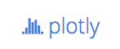






Interoperability Between Open Source Tools
Notes:
A new trend applicable to a university audience is the growth in interoperability between open source tools in statistics, programming and visualization. This growth is powered by the rise in data science and big data.

Slide 11
Proliferation of Visualization Software
Commercial
AutoCAD
GEOPAK
ArcGIS
SAS Visual Analytics
Tableau Desktop
Find software at NCSU Libraries: www.lib.ncsu.edu/software
Open Source
R (ggplot2, ggvis, shiny)
Python (Bokeh, Seaborn, Altair)
Plotly
Tableau Public
Vega-Lite
VTK
ParaView
QGIS
Carto
D3 & other .js libraries

Slide 12
Data Visualization Process
getting data
getting to know the data
setting goals
determining if a visualization is needed
deciding what to visualize
cleaning
visualizing
designing
exporting/embedding for presentation

Slide 13
Basic Design Considerations
Color
Type
S P A C E

Slide 14
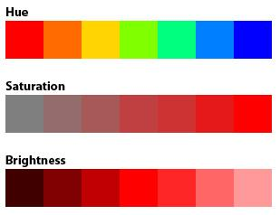
Color Characteristics
Hue = color name
Chroma = saturation
Value = brightness
Choose different hues when comparing categories that are not ordered. Consider grayer or more pastel shades over bold hues.
Keep same hue but vary chroma or brightness to show an ordered relationship
Notes:
Hue, Value, and Chroma are the 3 basic elements of color that can be leveraged in creating data visualizations. Highly saturated colors are attention grabbing but also whimsical. There are a number of factors that go into color selection. Each of these color variations can be written as a code that a computer can understand, either Hex or RGB value. They are different ways of writing the same thing. Hex codes are in base 16 and RGB is base ten. If you have the hex code “#0088FF”. This breaks down into:
Red: 00,
Green: 88,
Blue: FF.
The equivalent rgb would be rgb(0, 136, 255).(example taken from
A word of caution, color (hue) is not naturally ordered. It is best to use hue (color) for categorical data. Relative intensity or rank can be displayed using saturation or brightness. Color variation does have cultural significance, which is important to be aware of.

Slide 15
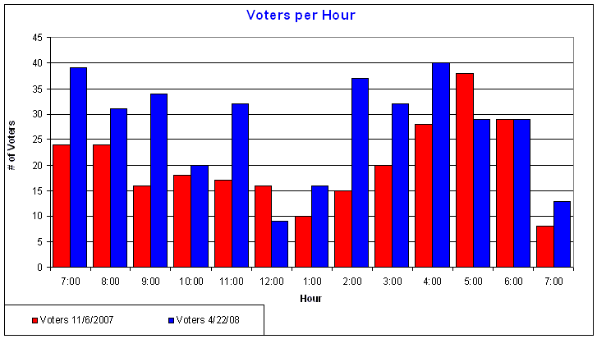
Color has cultural significance
Source: http://ridgerunnerconsulting.com/2008/04/more_voting_statistics/
Notes:
If you were looking at a chart with financial data that used a combination of red and blue what meaning would you infer from those colors? What do these colors signify?

Slide 16
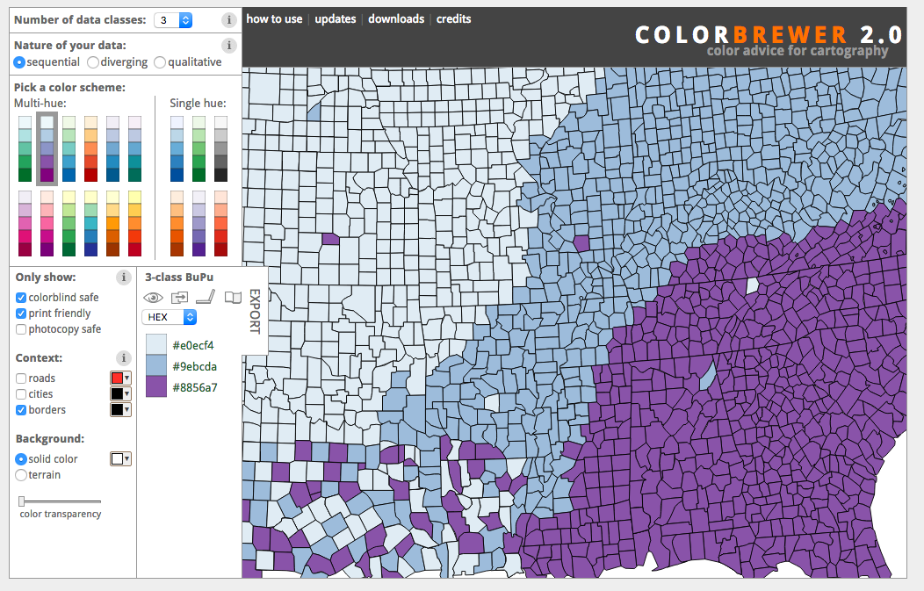
Tools for Picking Color Wisely
Color Brewer 2
Adobe Color Wheel
Notes:
It is important to consider your audience in terms of color blindness or other visual impairments. Also ask yourself if the differences in the colors you choose can be rendered when printed in black and white?
Color brewer (http://colorbrewer2.org/)
http://colorlab.wickline.org/colorblind/colorlab/
Adobe Color CC (https://color.adobe.com)

Slide 17

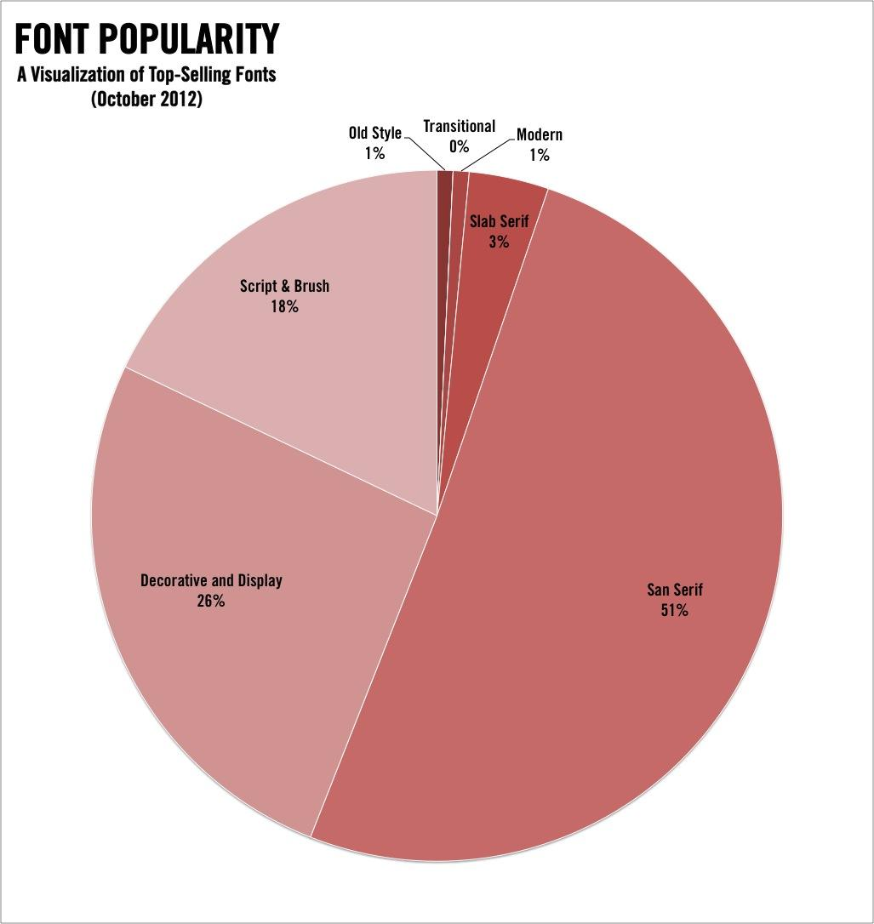
Type
Source
Source
Sans Serif fonts are better for digital displays and smaller captions
Limit the use of different font types to two!
Notes:
Font choice matters. Consider your audience and what you want to communicate. Most data viz software will default to a legible font (calibri, times new roman, arial). You do not have to stick with the default, but be sure to choose a font that is easy to read and professional. Sans serif fonts are most popular.

Slide 18
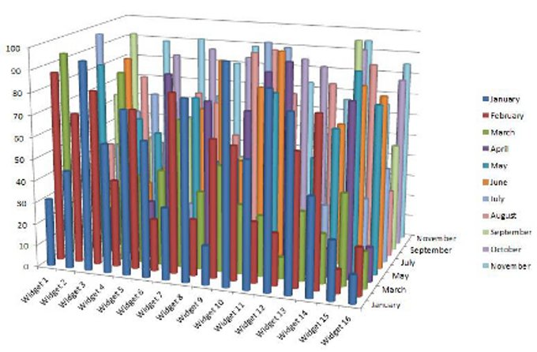
Space
Notes:
“Put the most data in the least space” is a heuristic of good visualization. But sometimes, people cram too much data into a space. This is an extreme example, but you can see that the message is meaningless when too much data is crowded into an inappropriate chart type. If your data geometries are overlapping and obscuring each other, consider using filters, summarizing, or subsetting the data. In some cases, you can use opacity to show points that overlap.
Source: http://cdn.information-management.com/media/newspics/Bling_fig3.jpg

Slide 19
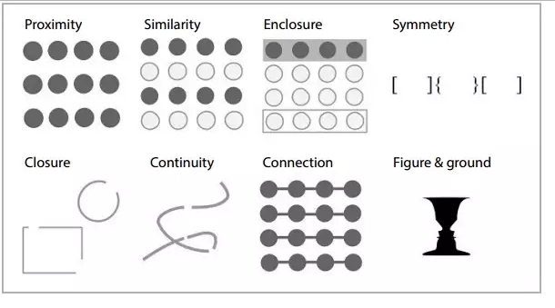
Gestalt principles
Source
Notes:
We see patterns and relationships based on how things are depicted visually, and where they are positioned. Good data visualizations are mindful of Gestalt principles.

Slide 20
Good vs. “Bad” Visualizations
Notes:
Let’s talk briefly about some things that make bad visualizations bad, and then get into best practices and general characteristics of good visualizations

Slide 21
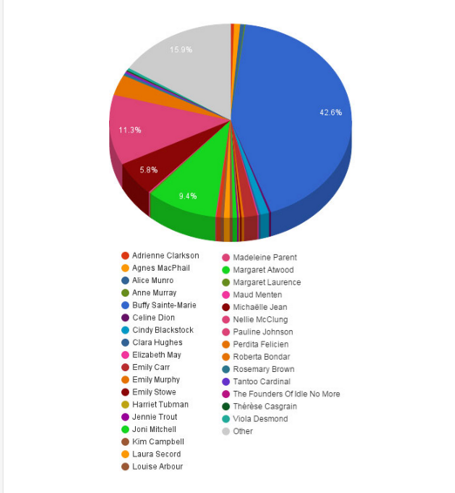
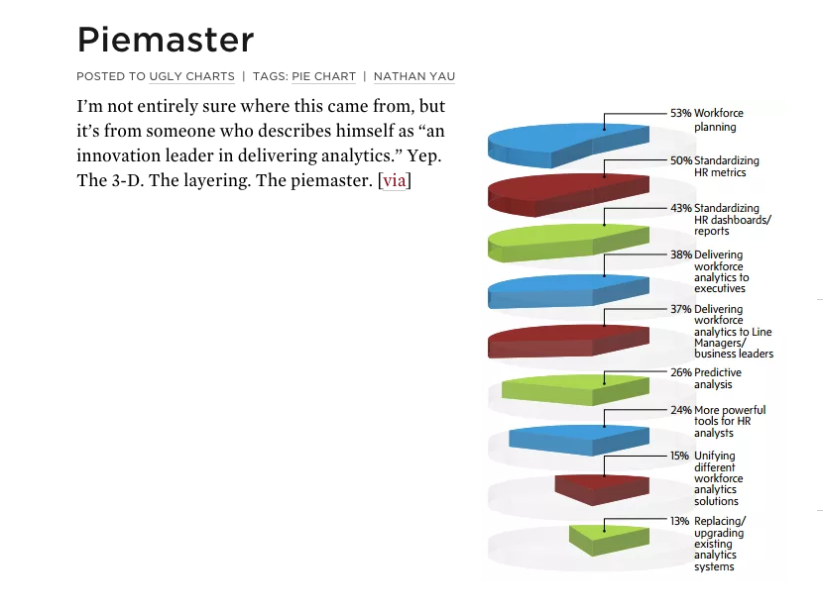
Characteristics of bad visualizations
Notes:
Bad visualizations require viewers to think too much, are confusing, misleading or distracting. Here there are so many choices it’s hard to tell what slice corresponds with what person. Most people can’t differentiate between that many colors. What was the purpose of this visualization? Hard to tell.

Slide 22
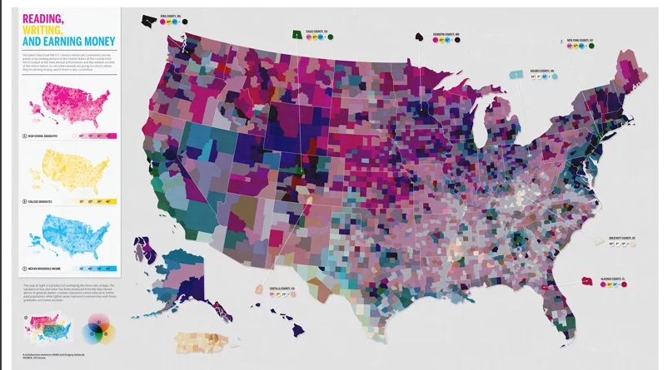
Bad visualizations confuse rather than reveal
Notes:
Some visualizations are bad because the data is too crowded or busy, which makes it difficult to interpret. Here, too many indicators are being visualized at once on this map, making the point of the visualization hard to determine.

Slide 23
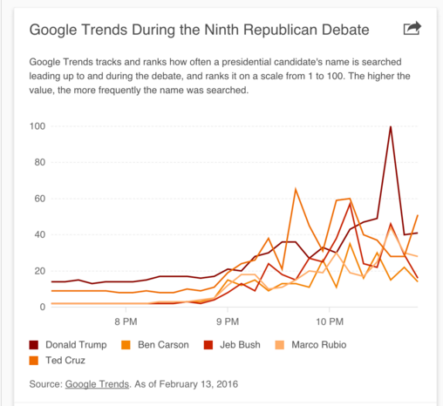
Bad visualizations are disorienting
Notes:
Incorrect use of graphs for the data is also a problem. A pie chart is best viewed in 2D. This view is disorienting and it’s hard to compare slices. The line chart looks inoccuous enough until you realize that it’s hard to distinguish between the colors, which makes it unreadable.

Slide 24
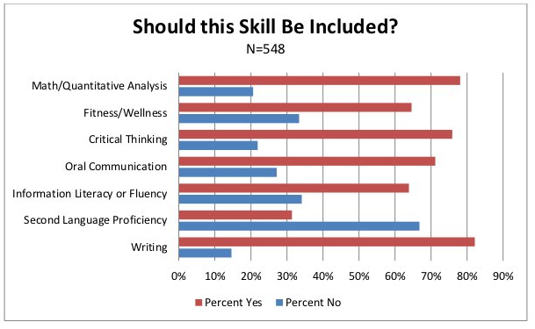
Mediocre visualizations aren’t good
Notes:
Most bad visualizations are simply mediocre. This visualization comes from a college department website and is one of many bad visualizations on that page. This is a bad visualization for a few reasons, some more obvious than others. Problems with this include: bars are unorded to it’s hard to compare across categories. Percentages never add up to 100. Labels are redundant along X axis. With a few changes, we can turn this into a much better visualization that’s easier to read and isn’t misleading.

Slide 25
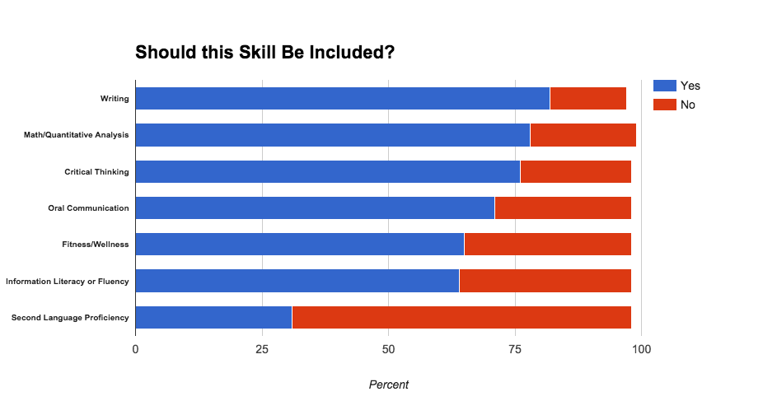
Visualization Makeover: Make it easier to interpret
Regular bar chart, unordered
Stacked bar chart, ordered by % Yes

Slide 26
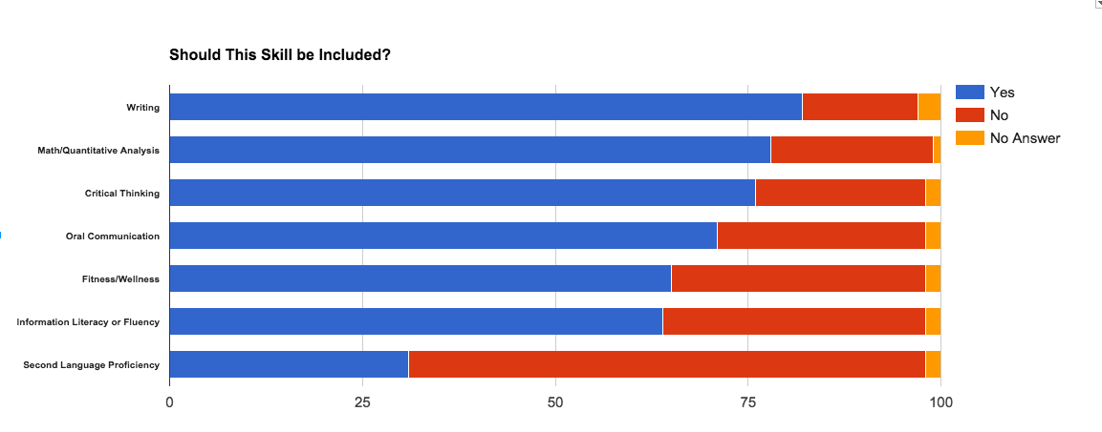
Correct misleading visuals
Tool used: Google sheets
Notes:
If you are recording percents, you need to have them add up to 100. Here, I added in a “No Answer” column to make up for the remaining percent. I could have also used “Other” Since I didn’t have the original data, I had to make the choice.

Slide 27
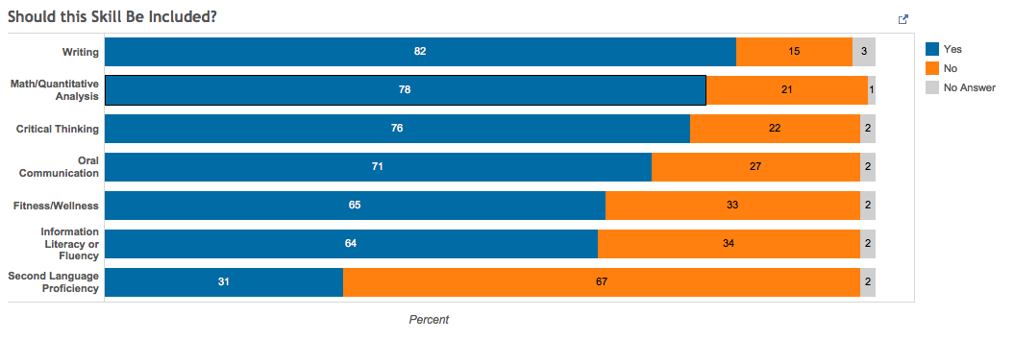
Taking it a step farther: Labels and color
Tool used: Tableau Public (www.tableau.com)
Notes:
Here, I have used colors that are better for people who are colorblind to be able to distinguish differences. I have also added bar labels to it’s really easy to see quickly the breakdown of percentages. This is only necessary if the numbers are important.

Slide 28
Best practices for making good visualizations
Make them easy to interpret (8-second rule).
Tell a story with annotation (titles, subtitles, and notations on the graph near the data)
Do not use hue to convey order. Blue does not come before yellow.
Utilize the length, size and/or position of visual marks to convey quantitative information.
Provide multiple levels of detail.
Consider color blindness.
Familiarize yourself with Gestalt Principles.
Source
Notes:
These theories attempt to describe how people tend to organize visual elements into groups or unified wholes when certain principles are applied. For example, when visual objects are similar, people tend to perceive them as a group. When elements are placed close together, people tend to percieve them as a group or cluster.

Slide 29
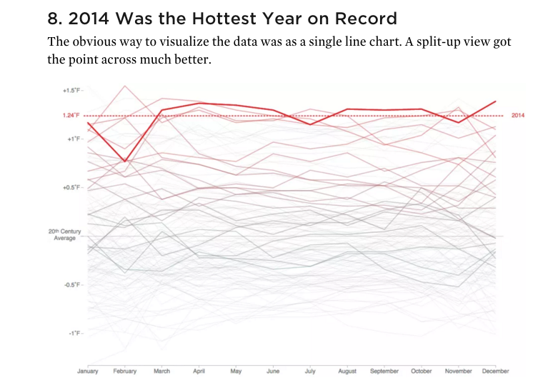
Good visualizations point out what’s important.
Bold colors used to highlight only.
Source:
Flowingdata.com
Notes:
This line chart would be a bad visualization if all of the lines were bold, but here, the author has used color to highlight what’s important.

Slide 30
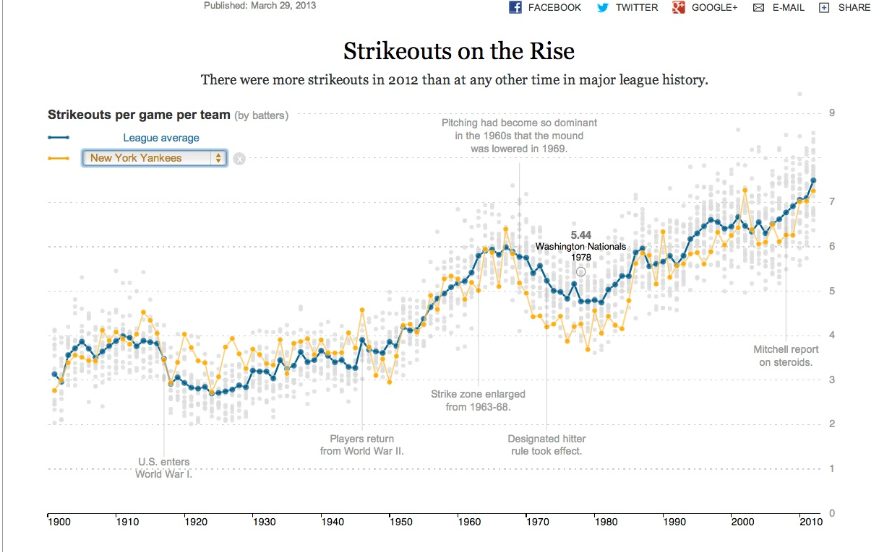
Good visualizations tell a story
Notes:
This chart has annotations that convey story points and enable the viewer to better understand peaks and valleys or sudden changes in the lines. The title and subtitle are used to convey the most important takeaways.

Slide 31
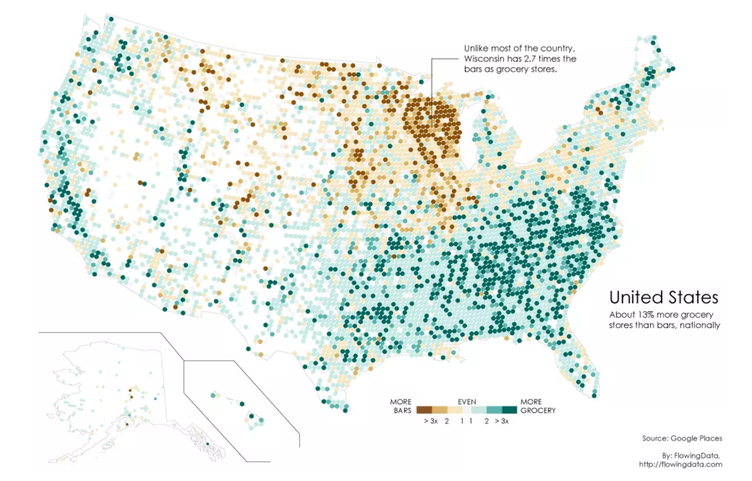
Good visualizations use color and notation to aid interpretation
Notes:
This is a lot of data but this visualization is successful in part because of the color scale used.

Slide 32
Choosing the Right Chart Type
(or rather, geometries and aesthetics)

Slide 33
Research findings
From Robert KosaraThe Science of What We Do (And Don’t) Know About Data Visualization:
“...lines imply transitions whereas bars imply individual values.”
“We remember points not where they are in the plot, but shift them towards clusters in our memory, and let them drift slightly downwards.”

Slide 34
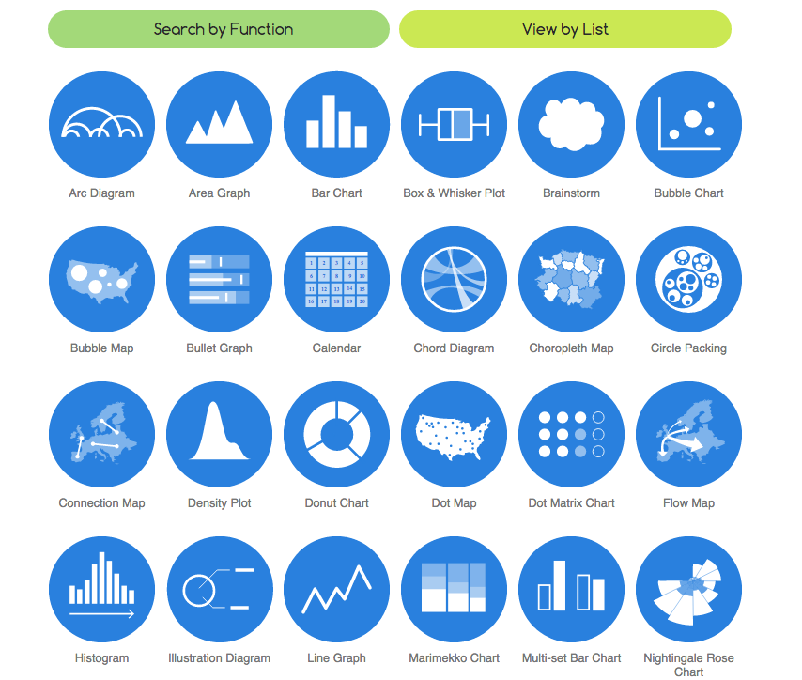
Data Viz Catalogue - www.datavizcatalogue.com
Notes:
Choosing the right chart often depends on what you’re trying to show with your data. The Data Viz catalogue offers some helpful suggestions of chart types and tools.

Slide 35
Alternatives to the status quo
Common chart types may be fine, but there are others out there:
“Six alternatives to the clustered bar chart” - Ann K. Emery
annkemery.com/clustered-bar-chart
“Alternatives to pies” - Cole Nussbaumer Knaflic storytellingwithdata.com/blog/2014/06/alternatives-to-pies

Slide 36
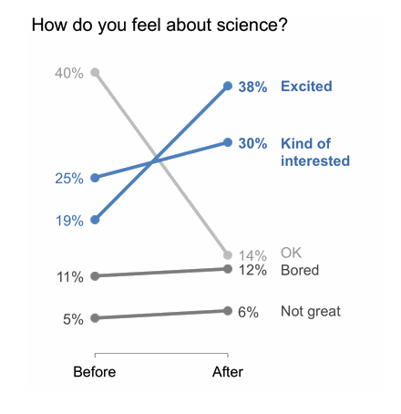
Slope graphs: showing change over time
Notes:
Slope charts can be interesting alternatives to a bar chart or a pie chart -- they can be good for showing change over time, especially before/after comparisons, like pre- and post- survey results

Slide 37
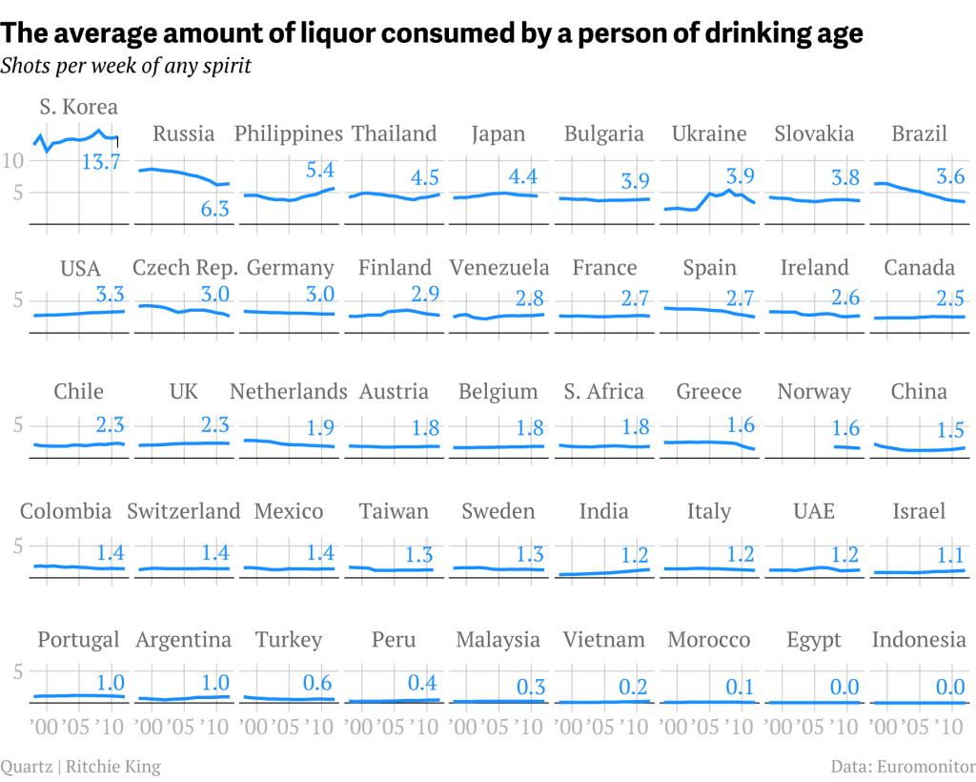
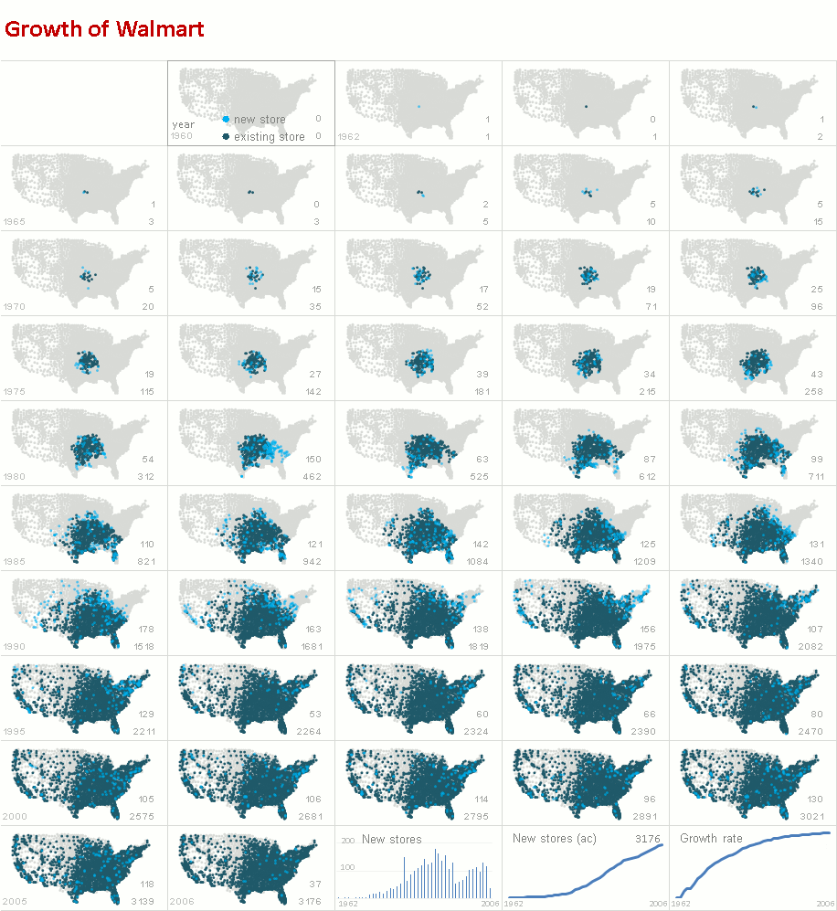
Small multiples charts and maps:
good for showing lots of data without overcrowding
excelcharts.com
Notes:
A great way to prevent having too many lines in one chart and also are good for showing change over time

Slide 38
Further Resources
“Color Harmonies: Basic Techniques for Combining Colors” (Tiger Color website)
“Choosing Colors for Data Visualization” (Maureen Stone)
Data visualization [electronic resource] : a successful design process (Andy Kirk)
The functional art : an introduction to information graphics and visualization (Alberto Cairo)

Slide 39
Discuss examples on your handout
in small groups
How could they be better?
What would you do differently?
go.ncsu.edu/startviz2

Slide 40
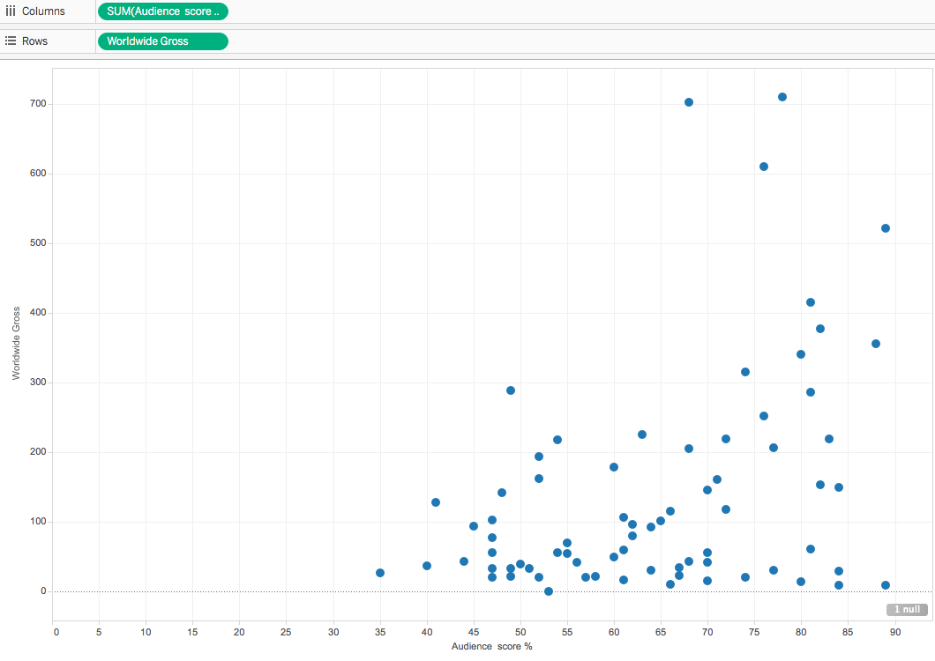
Example 1: Scatterplot This graph shows audience score (X-axis) and Worldwide Gross revenue in millions of dollars (Y-axis). The purpose of this graph is to see if there is a correlation between box office gross revenue and a film’s audience score.

Slide 41
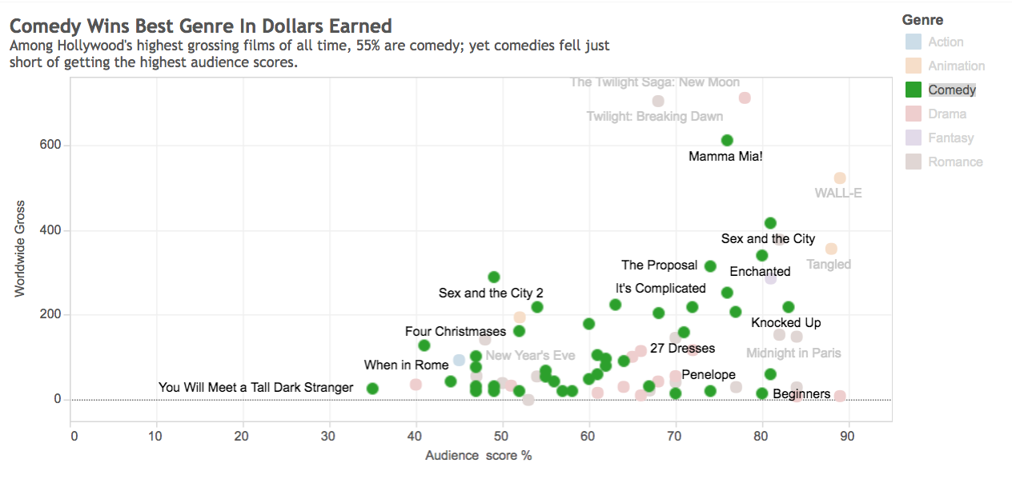
Improved example

Slide 42
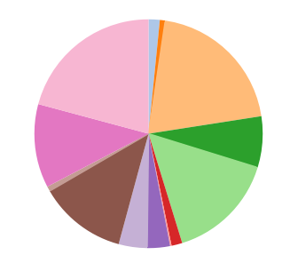
Example 2: Pie Chart
This pie chart attempts to show how much film studios compare in terms of gross revenue.

Slide 43
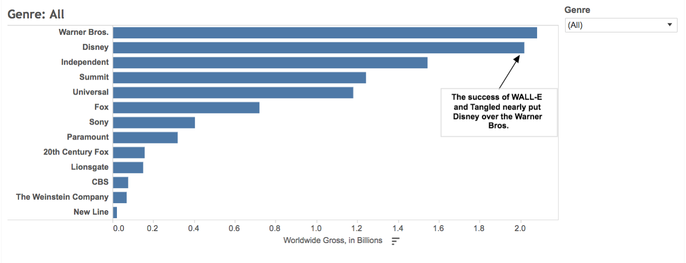
Improved example

Slide 44
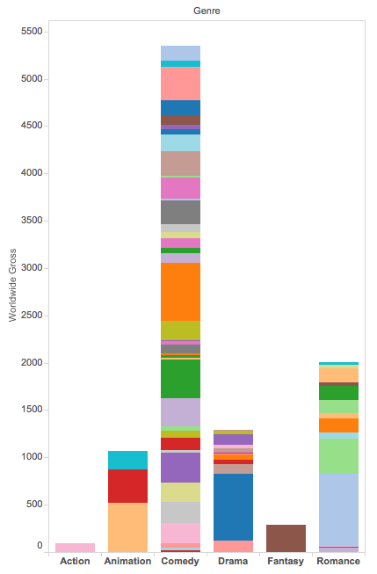
Example 3: Bar chart
This bar chart shows worldwide gross by film and genre. It’s too busy and needs help!

Slide 45
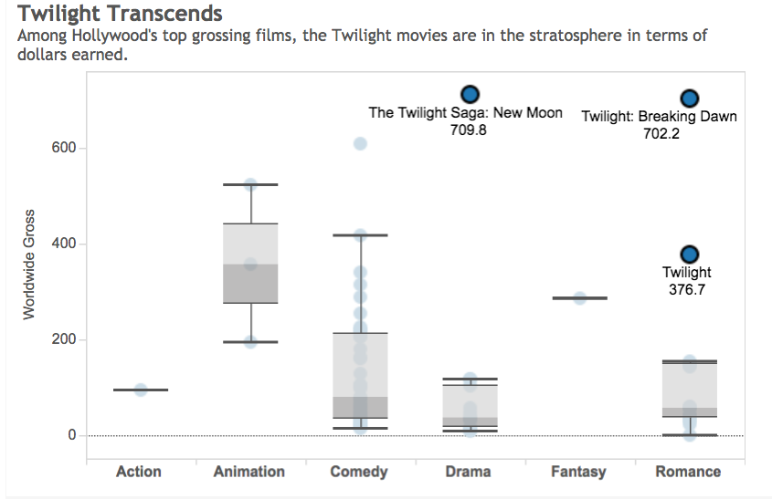
Improved example

Slide 46
Improved examples
Here’s a link to a workbook with the examples from the activity:
https://public.tableau.com/profile/al.blaine#!/vizhome/ImprovedExamples/AudienceScorevsWorldwideGross

